Slide 1
Capstone Project - The Battle of Neighborhoods (Week 2)
Venue Suggestion to Opening a Japanese Sushi Restaurant in Toronto, Canada
YuiTak Cheung

Slide 2
Finding an optimal location for a Sushi Bar in Toronto
This project will be delivering a reference venue for people who are interested in opening a Sushi store in Toronto, Canada.
To conclude the existing Sushi restaurants compared to all other restaurants
Use clustering to find similar areas in Toronto regarding restaurants of each borough
The preferred area shall be distant from existing restaurants
Use data science tools to fetch the raw data, visualize it then generate a few most promising areas based on the above criteria

Slide 3
Data acquisition and cleaning
Borough and Neighborhood found by csv file provided and from wikipedia
Restaurant data in every neighborhood will be obtained using Foursquare API
Extract the coordinates of all Asian restaurants. With the information about venues around a given neighborhood
15 boroughs and 103 neighborhoods found in Toronto
3904 Asian restaurants were found from Foursquare, 701 of which are Sushi restaurant
Duplicated items or items with incomplete information were dropped
Clean data contains 692 Asian restaurants in Toronto (103 Sushi)

Slide 4
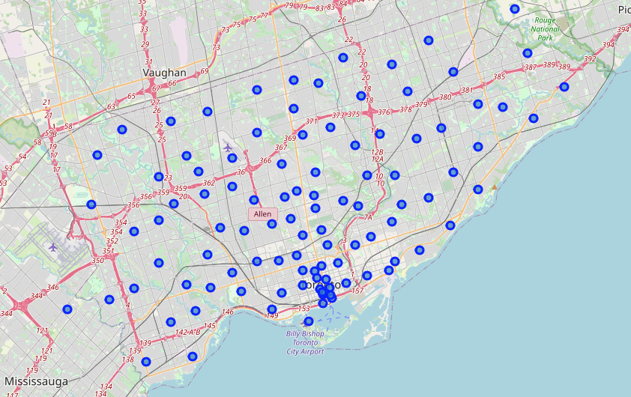
Visualization of location of neighborhoods in Toronto
Map of Toronto, Canada and the coordinates of the neighborhood centers using folium maps. City center in South near the coast

Slide 5
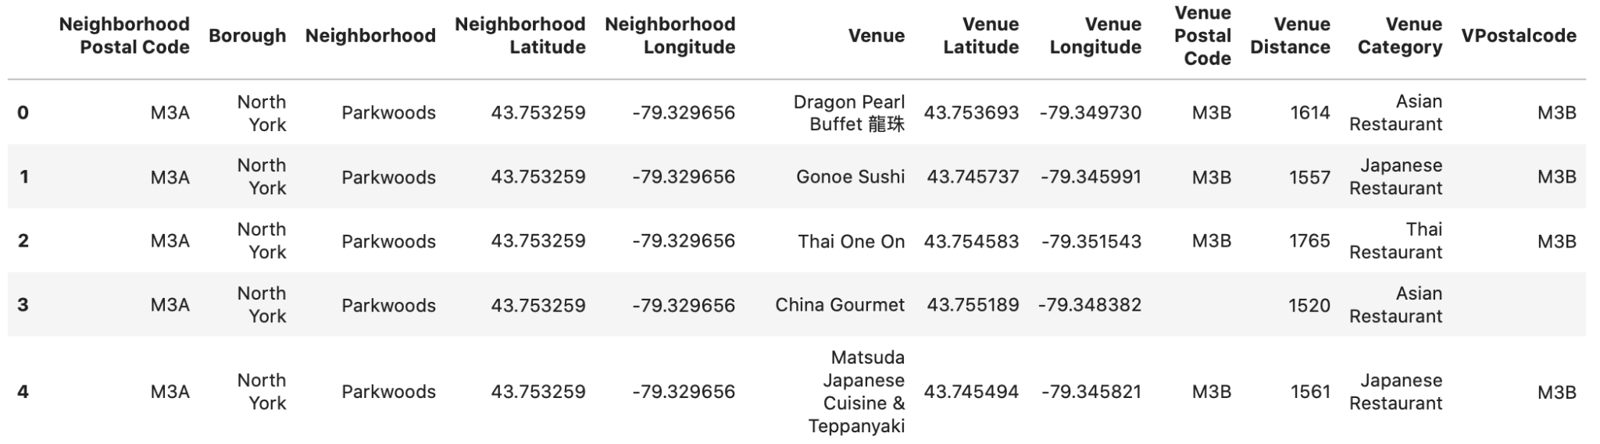
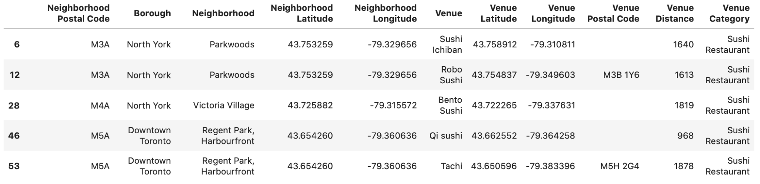
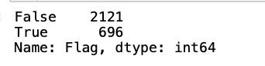
Extract info for Asian restaurants and Sushi bars
For each neighborhood, Max. 2000 Asian restaurants from the center radius of 2000m were extracted from Foursquare, with names, coordinates, postal codes and category
696 restaurants remained after data wrangling

Slide 6
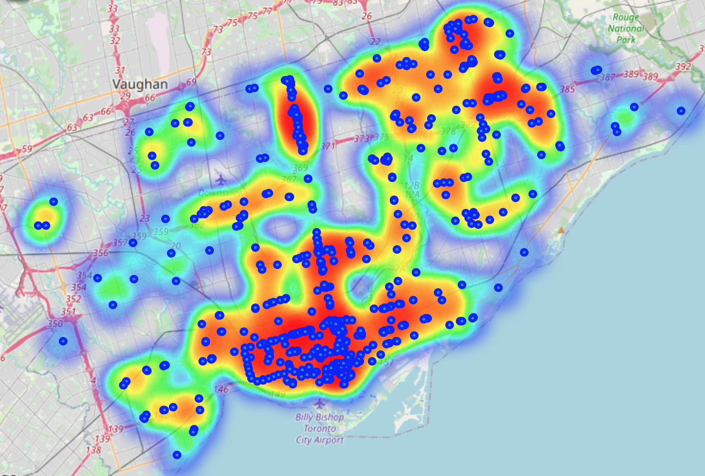
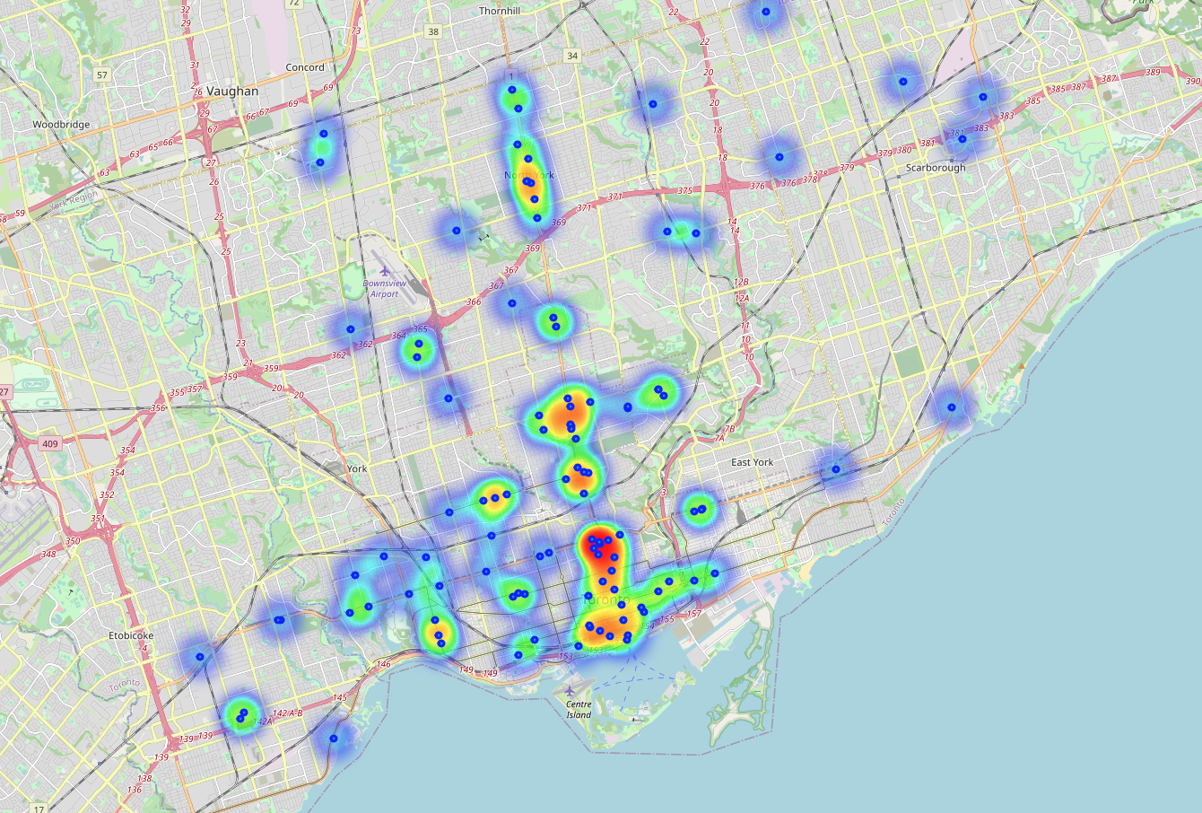
Heatmap of Asian and Sushi Restaurants in Toronto
Asian Restaurants
Sushi Restaurant

Slide 7
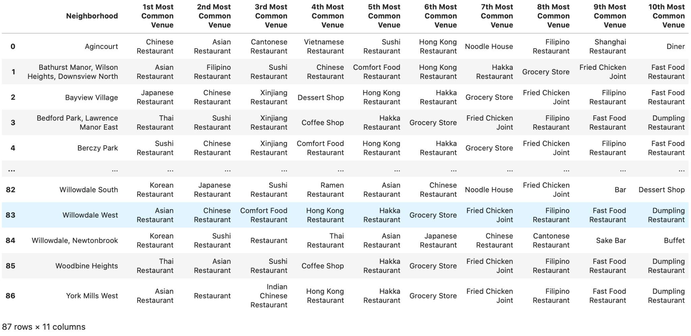
Top 10 Asian restaurant types for each neighborhood

Slide 8
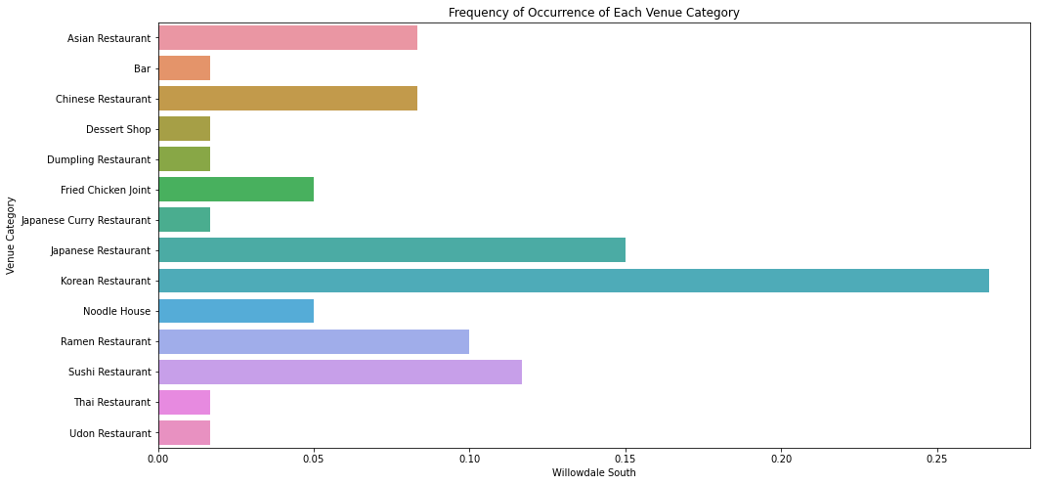
Neighborhood with most Asian food, Willowdale South
The Willowdale South neighborhood in North York is the area with the most venues. As seen in the graph, the third common types of food venues in this region are Sushi Restaurants. It is far from the Downtown and is capable for a large number of Asian restaurant business.

Slide 9
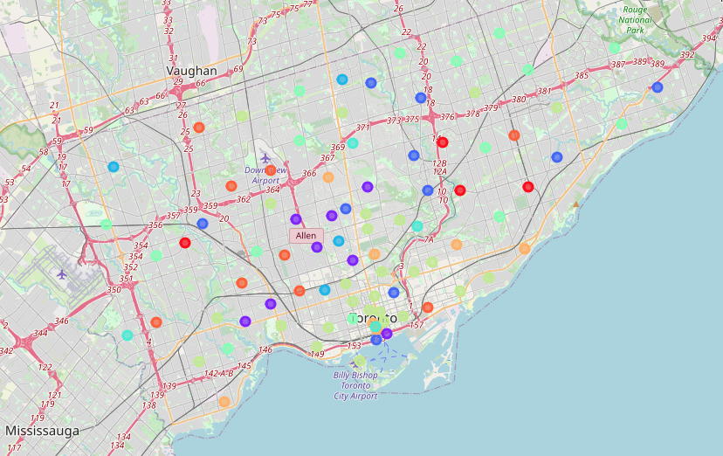
K-mean cluster for neighborhood based on top 10 type
Number of clusters : 9
Number of time the k-means algorithm will be run with different centroid seeds: 100

Slide 10
Discussion and Conclusion
The most popular area in the city of Toronto in terms of Asian food venues is the neighborhood Willowdale South in the North York borough
From this analysis can we understand that this area has great capability for Asian food venues. However, there are many things to consider when choosing a place for the food venue. For example it may be a valuable place which may not be an optimal choice for some food venues
We focus only on the competition and restaurant density. In order to evaluate this factor, we presented the neighborhood-based venues we collected and how often they were in which neighborhood as a result of our analysis. For example, although the area consisting of the neighborhood seems like an attractive location, it may not be a good idea for venues
If we are looking for a venue in similar style, we can also consider the neighborhood with the same cluster number, (i.e. 1), such as Don Mills North, The Beaches, Bayview Village etc, at the nearby areas.
Finally, the fact that this study is not inclusive may reveal some drawbacks. One of them is that the information we provide is far from offering pinpoint options for stakeholders. The reason for this is that our analyzes are far from the real field. Therefore, the information we provide will only help stakeholders to choose a starting point in finding a new location for their business.

